Slide 1
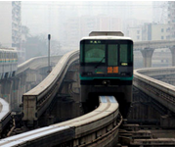
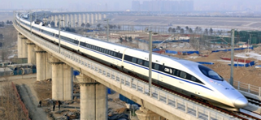
Application of ZINGA Film Galvanising On Railway Transport
www.zinga.eu www.zinga.cn

Slide 2
Primo Corporation (Shanghai) Ltd. ZINGA Film Galvanising - Exclusive Distributor China

Slide 3
ISO 12944 – Standard for steel structure corrosion protection ISO 12944 is currently the most authoritative international standard for corrosion protection of steel structure coatings. It sets the guidelines and norms for formulating corrosion protection schemes of steel structures.

Slide 4
1、ISO 12944-2: Atmospheric Corrosive Environment Classification Environmental rating is based on the weight of carbon steel lost within one year of exposure to different environmental conditions
Classification of environments | Corrosion level | Mass loss (g/m²) | Typical outdoor environment | Typical indoor environment
C1 | Very Low | <10 | Rural / dry areas, neutral atmosphere | Heating room
C2 | Low | 10～200 | Low pollution, dry area | Condensation may occur in unheated rooms
C3 | Medium | 200～400 | Urban and industrial atmosphere, moderate SO₂ pollution | High humidity, some places polluted by air
C4 | High | 400～650 | Industrial and coastal environment | Chemical plant, swimming pool
C5 – I C5 –M | Very high (Industrial) M Very high (Marine) | 650～1500 | Coastal and offshore buildings | Buildings and places where there is always condensation and high humidity
CX | Extremely severe corrosion | 1500～5500 | High salinity in coastal and offshore areas and harsh industrial areas | Buildings and places that are always in high humidity and heavy pollution

Slide 5
● For different coating systems, the Standard specifies the anticorrosive life of the coating under different environments, and it is classified into three ranges: short-term (2-5 years), medium-term (5-15 years) and long-term (> 15 years). ● The definition of anti-corrosion life is similar to the design life in engineering design, that is, the life of the first overhaul of the coating system .
2、ISO 12944-5: Specification of
of anticorrosive life

Slide 6
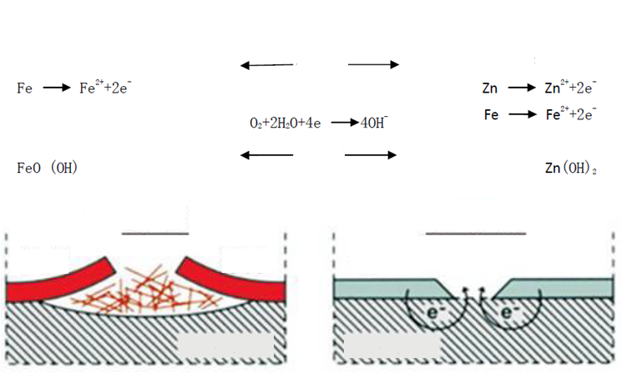
Corrosion of steel
Non-cathodic protection
Cathodic protection
Coating system
Protective coating
Coating system
Reacts to air and moisture
generates
Corrosion occurs
No corrosion
paint
paint
zinc
zinc
Fe
Fe

Slide 7
Common commons of industrial corrosion protection
Barrier protection
Single coating
Multi-layer coating
Additional material
Cathodic protection
Electrophoresis / electroplating
Hot dip galvanizing（HDG)
Thermal spray zinc / aluminum (by torch or electric arc)
Cold applied film galvanized

Slide 8
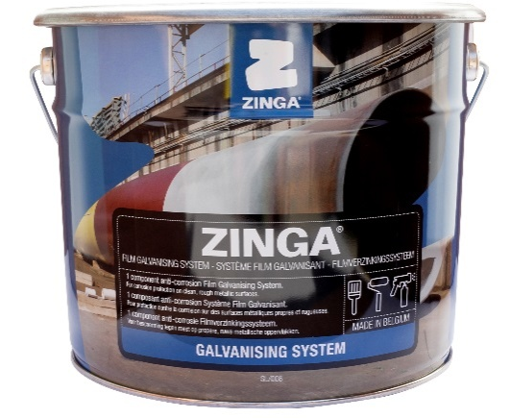
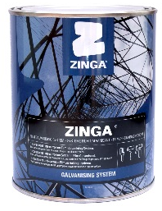
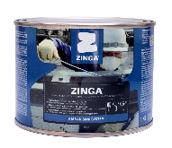
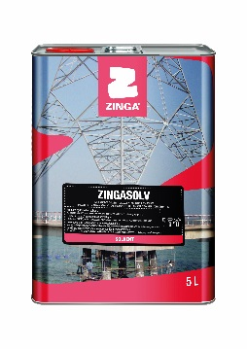
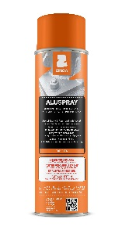
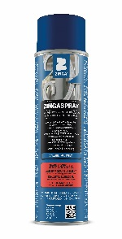
Packing Specifications
Product name | Packing
Zinga | 1、2、5、10、25 Kg/can
Zingasolv | 1、5、25 L/can
Aquazinga | 10、25 Kg/set
Zingaspray | 500 ml/can

Slide 9
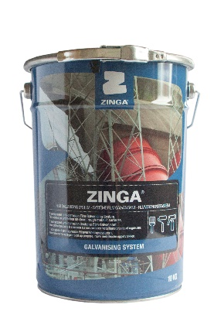
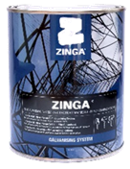
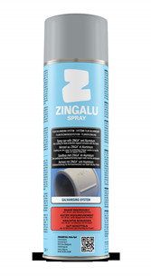
Current Activities
Production and sales of ZINGA range
of products
Expansion of distributorship
95 distributors in >100 countries:
Africa, Asia, Australia & NZ
Europe, Middle East
North & South-America
Expansion of range of products
ZINGA as primer or shop-primer
ZINGA as stand-alone system
Sealers
Topcoats

Slide 10
Comparison of ZINGA
and Zinc Rich Paints
ZINGA
1. Zinc powder - refined by
atomization
ɸ 3－5 μm
Zinc content in dry film = 96％
Zinc powder purity = 99.995%
(no lead, cadmium or other heavy metals）
2. Neutral resin: conductive
3. Aromatic solvent: naphtha; non-
toxic
Zinc Rich Paints
1. Zinc powder - refined
by distillation
ɸ 12－15 μm
Zinc content in dry film = 70-85％
Zinc powder purity = 98％
(contains heavy metals such as
lead & cadmium ）
2. Organic resin
3. Solvent contains harmful toluene,
xylene, acetone

Slide 11
Advantages of ZINGA
Durable Corrosion Resistance
1. Determination of resistance to neutral salt spray ：9500 hours
2. Corrosion rate 1/3 of hot-dip（corrosion rate as immersed in salt solution ）
HDG = 0.110 mm/yr
ZINGA = 0.035 mm/yr
3. ISO 12944-6 certifications
- ZINGA 2 x 60 µm
- ZINGA 2 x 90 µm
- ZINGA 60-80 µm + epoxy MIO intermediate paint 120 µm
+ finish 60 µm [C5-I High]

Slide 12
Advantages of ZINGA
Coating Characteristics
Good adhesion - test results：0-1 (cross-cut method)
6.5–10.1 Mpa (pull-off method)
2. Excellent flexibility (Φ1 mm) & impact resistance (50 mm)
3. Excellent abrasion resistance：0.0451 g (500g,1000 revolutions)
4. Excellent moisture and heat resistance; wide working
temperature range：-40℃～150℃
5. Weldability - DFT <60 µm not affecting welding quality
6. Unique reliquidability, repeated overcoating without having to remove old layers

Slide 13
Advantages of ZINGA
Application Performance
ZINGA is single component, easy to apply and repair /maintain.
Can be applied by air support /airless spraying, brush, roller, dipping, electrostatic spraying.
Surface treatment not demanding, and can be applied on rusted surface (St 2).
Dries quickly – touch dry in 10-15 minutes (below 23 C)
5. Can be applied on wet metal surfaces
6. Can be applied under ambient condition of relative humidity ≤ 95%

Slide 14
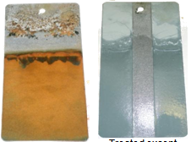
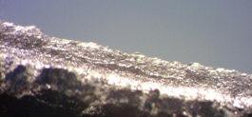
Advantages of ZINGA
Product Performance
Active, cathodic, galvanic
protection → very high zinc
content (96%)
vs hot-dip, metallisation
Passive barrier protection
→ zinc salts on top of surface
vs protective paints
One component organic zinc coating
ZINGA is NOT a paint
- Does not form a closed film
- Will never crack
- will never peel off
Treated except 2cm strip
Untreated
ZINGA layer

Slide 15
Advantages of ZINGA
Product Performance
Galvanised structures can be recharged or reloaded with ZINGA
ZINGA on ZINGA
ZINGA on metallised or HDG
Each new layer of ZINGA blends perfectly with the previous one
Additional layers all blend to form one single, homogeneous ZINGA layer
Application of 2nd pass ZINGA on copper particles ;
The copper particles blend
in the two layers of ZINGA
Copper particles in between
the two layers of epoxy paint.
Epoxy does not blend together !
Copper particles on top of ZINGA

Slide 16
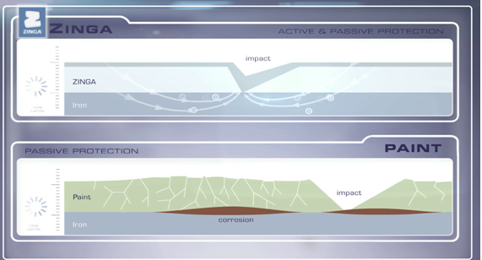
ZINGA Anti-corrosion Principle

Slide 17
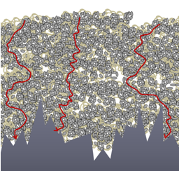
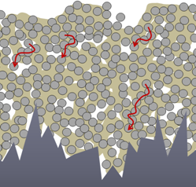
ZINGA vs Zinc Rich Paint
ZINGA
Zinc rich paint
ZRC zinc particles are 3--5 times larger than Zinga zinc particles

Slide 18
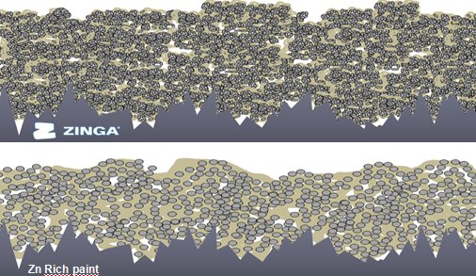
ZINGA vs Zinc Rich Paint

Slide 19
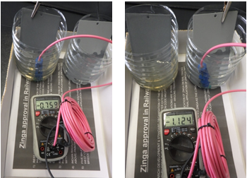
ZINGA vs Zinc Rich Paint
Electrode potential measurement
ISO 15711-2003
Electrode potential measurement
Determination of coating sacrificial anode and protective cathode performance ：
ZINGA = -1114 mV
Zn rich paint = -752 mV
Uncoated = -682 mV
Other zinc rich paint
ZINGA

Slide 20
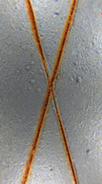
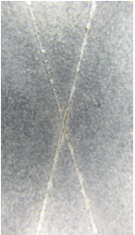
ZINGA vs Zinc rich paint
Immersion test
After 7 days of exposure to salt water
Other zinc rich paint
ZINGA

Slide 21
Project References

Slide 22
Project ： Shanghai Maglev TransRapid – functional parts
Location ：Shanghai (Lujiazui to Pudong Int’l Airport, 37 km)
Cating system ：ZINGA 80 µm + Epoxy sealer 30 µm + Epoxy micaceous iron intermediate paint 100 µm + Over-coatable polyurethane finish 60 µm

Slide 23
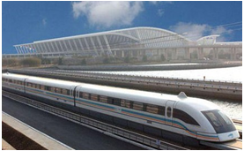
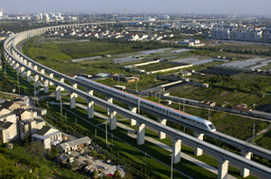
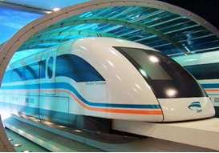

Slide 24
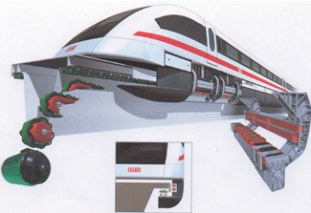
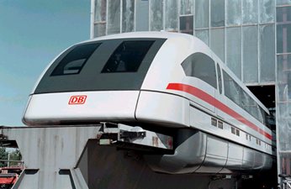

Slide 25
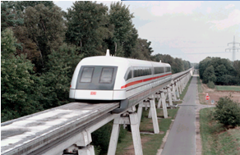
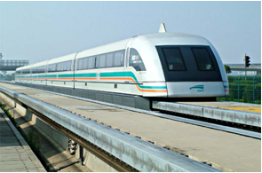

Slide 26
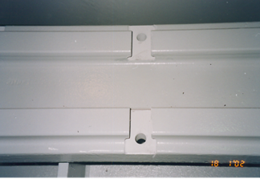
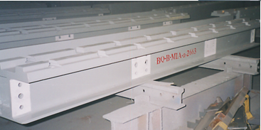

Slide 27
Project ： Zuibaichi Station of Shanghai Metro Line 9
Location ：Shanghai
Coating system ：ZINGA 60 µm + Epoxy sealer 30 µm + Epoxy micaceous iron intermediate paint 100 µm + Fluorocarbon finish 60 µm

Slide 28
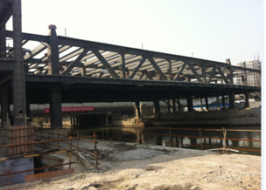
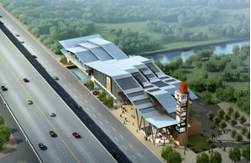

Slide 29
Project ：Chongqing Monorail Line 1
Location ：Chongqing
Coating system ： ZINGA stand-alone on rebars 1 x 40 µm；
PC column support plates 2 x 50 µm
Completion date ：2001.7.30

Slide 30
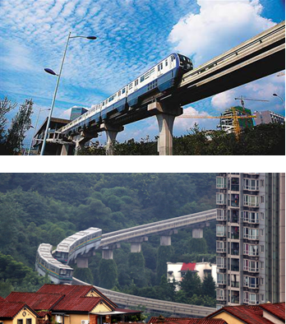
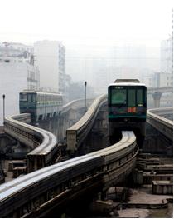

Slide 31
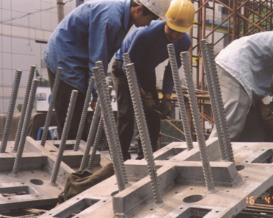
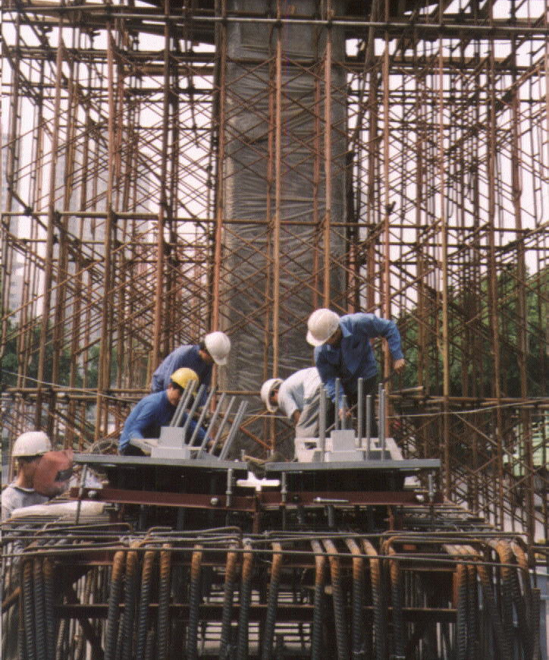

Slide 32
Project ： Chongqing Monorail Line 1 Track Bifurcation
Location ：Chongqing
Coating system ：ZINGA 60 μm + Epoxy sealer 30 μm + Epoxy micaceous iron intermediate paint 80 μm + Over-coatable polyurethane finish 2 x 30μm
Completion date：2001.7.3

Slide 33
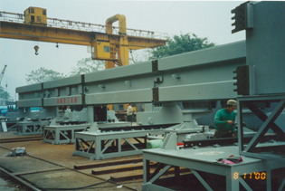
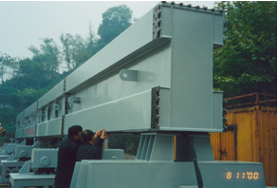

Slide 34
Project ：Beijing-Shanghai High-speed Railway Link
(protection of rebars)
Location ：Xuzhou to Tangshan section
Coating system ：ZINGA stand-alone 1 x 40 μm

Slide 35
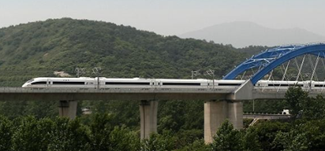
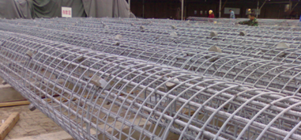

Slide 36
Project ： Shanghai Metro Line 11
Location ： Shanghai
Coating system ：ZINGA stand-alone 2 x 60 μm

Slide 37
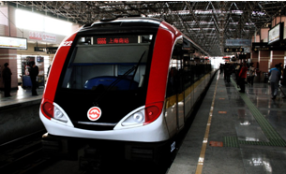
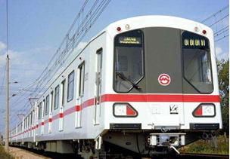

Slide 38
Project ： Shenzhen Metro Line 1
Location ：Shenzhen
Coating system ：ZINGA stand-alone 2 x 60 μm

Slide 39
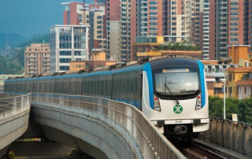
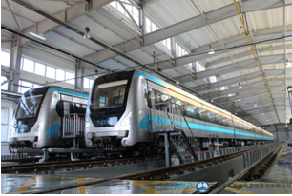

Slide 40
Project ： Beijing Metro Line 4
Location ： Beijing
Coating system ：ZINGA stand alone 2 x 60 µm

Slide 41
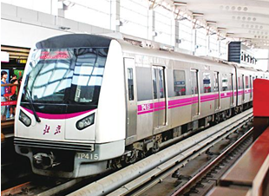
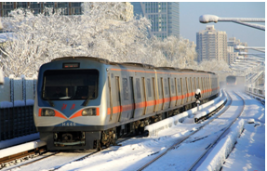

Slide 42
Project ： Beijing Intercity Railway S2 Line
Location ： Beijing
Coating system ：ZINGA stand-alone 2 x 60 μm

Slide 43
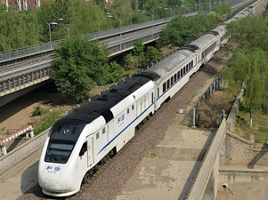
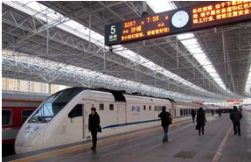

Slide 44
Project ： Guangzhou Metro Line 3
Location ： Guangzhou
Coating system ：ZINGA stand-alone 2 x 60 μm

Slide 45
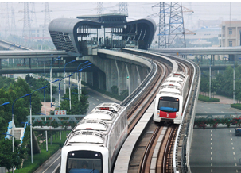
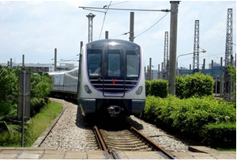

Slide 46
Project ： Hong Kong MTR
Location ： Hong Kong
Coating system ：ZINGA stand-alone 2 x 60 μm

Slide 48
Project ： Guangzhou-Shenzhen-Hong Kong High-speed
Railway - Hong Kong section
Location ： Hong Kong
Coating systems ： Reinforcement of underground space at West Kowloon Terminus - ZINGA 1x 40 um；steel structures of terminal building - ZINGA 60um + Epoxy micaceous iron intermediate paint 120 um ＋ Polyurethane finish 50 um

Slide 51
Project ： Guangdong Yuehai Passage Railway – pier steel
fenders
Locations ：Haikou, Hainan and Zhanjiang, Guangdong
Coating system ：ZINGA 2 x 40 μm + AUQAZINGA 2 x 40 μm
Completion date：Dec 2001

Slide 54
Project ： SMRT
Location ：Singapore
Painting scheme ：ZINGA stand-alone 2 x 60 μm

Slide 57
Project ： London Underground
Location ： London
Painting scheme ：ZINGA stand-alone 2 x 60 µm

Slide 59
涂装前

Slide 60
Project ： Brasilia Railway
Location ： Brasilia, Brazil
Coating system ：ZINGA stand-alone 1 x 80 µm

Slide 63
Project ： Onping 360 SkyRail Cable Cars
Location : Lantau, Hong Kong
Coating system : ZINGA stand-alone 2×75 μm
Completion date: 2006

Slide 70
Project ： Guangzhou New TV Tower Ferris Wheel
Location ：Guangzhou
Coating system ：ZINGA 80µm＋Epoxy sealer 30µm＋
over-coatable polyurethane finish 60µm
Completion date: 2010.9

